Slide 1
UFCFB6-30-2 Object-oriented Software Development
Unit 8 Software testing
Benedict R. Gaster
2016-17

Slide 2
Outline
Testing: Validation and defect testing
Stages of testing
Testing techniques
Test-driven development

Slide 3
Characteristics of software
All large software contains errors
Problems with requirements capture
Design is never optimal first time
Implementation issues
We can almost never find all the errors in software. It is impossible to state that software is error free.

Slide 4
Testing: Validation and defect testing
Testing is intended to show that a program does what it is intended to do and to discover program defects before it is put into use.
The first goal leads to validation testing
You expect the system to perform correctly using a given set of test cases that reflect the system’s expected use.
The second goal leads to defect testing
The test cases are designed to expose defects. The test cases in defect testing can be deliberately obscure and need not reflect how the system is normally used.
Notes:
e.g. add book in bookshop example, you enter a new book, and then check it is in the list.
Purchasebook, enter books that already in the system.
Defect: you deliberately enter invalid books. To see if system can detect and how it deals with it

Slide 5
Stages of testing
Development testing, where the system is tested during development to discover bugs and defects.
Release testing, where a separate testing team test a complete version of the system before it is released to users.
User testing, where users or potential users of a system test the system in their own environment.
Notes:
Alpha:
Normally performed by test engineers, employees, and sometimes “friends and family”. Focuses on testing that would emulate ~80% of the customers.
Alpha testing is performed by the users within the organization developing the software. It is done in a lab environment so that user actions can be measured and analyzed. Its purpose is to measure real users’ abilities to use and navigate the software before it can be released to the general public. Alpha testing includes unit testing, component testing, and system testing. The developers use either debugger software, or hardware-assisted debuggers, that help catch bugs in the system quickly.
Beta:
Tested in the “real world” with “real customers” and the feedback can cover every element of the product.
Beta testing, generally involves a limited number of external users. At this time, beta test versions of software are distributed to a select group of external users, in order to give the program a real-world test. This is done to ensure that the product has few faults or bugs and that it can handle normal usage by its intended audience. Sometimes, the beta versions are made available to the open public to increase the feedback

Slide 6
Development testing
Development testing includes all testing activities that are carried out by the developing team.
Unit testing, where individual program units or object classes are tested. Unit testing should focus on testing the functionality of objects or methods.
Component testing, where several individual units are integrated to create composite components. Component testing should focus on testing component interfaces.
System testing, where some or all of the components in a system are integrated and the system is tested as a whole. System testing should focus on testing component interactions.
Notes:
A unit test is an automated piece of code that invokes a unit of work in the system and then checks a single assumption about the behavior of that unit of work.
A unit of work is a single logical functional use case in the system that can be invoked by some public interface (in most cases). A unit of work can span a single method, a whole class or multiple classes working together to achieve one single logical purpose that can be verified.
The Unit Testing involves testing of individual programs, modules, or components to demonstrate that the program executes as per the specification and it validates the design and technical quality of the application. In Unit Testing, the Called Components (or Communicating Components) are replaced with Stubs, Simulators, or Trusted Components. Testing Stubs or Drivers are used to simulate the behavior of interfacing modules. The Component Testing is like Unit Testing with the difference that all Stubs and Simulators are replaced with the real objects. Here a Unit is a component, and integration of one or more such components is also a Component. Whereas Integration Testing is the test process which begins after two or more programs components have been successfully unit tested. It is conducted by the development team to validate the interaction or communication/flow of information between the individual components that will be integrated.
testing, e.g. for the part that deals with book catalogues, listAllBooks interface needs to use methods in the BookContainer and the Book class
System testing of software or hardware is testing conducted on a complete, integrated system to evaluate the system's compliance with its specified requirements.

Slide 7
Object class testing
Complete test coverage of a class involves
Testing all operations associated with an object
Setting and interrogating all object attributes
Exercising the object in all possible states.
Inheritance makes it more difficult to design object class tests as the information to be tested is not localised.

Slide 8
Unit test effectiveness
This leads to 2 types of unit test case:
The first of these should reflect normal operation of a program and should show that the component works as expected.
The other kind of test case should be based on testing experience of where common problems arise. It should use abnormal inputs to check that these are properly processed and do not crash the component.
Notes:
The test cases should show that, when used as expected, the component that you are testing does what it is supposed to do.
If there are defects in the component, these should be revealed by test cases.
Example of adding book
If book not initialised, trying to get details of book leads to null pointer

Slide 9
Testing techniques
Partition testing, where you identify groups of inputs that have common characteristics and should be processed in the same way.
Each of these groups is an equivalence partition or domain where the program behaves in an equivalent way for each class member.
Examples: application involves mapping marks to grades, 0-34 is one group, 35-39 is one group, 40-49 is one group and 50-59 ….. No need to test every possible number within each group.
Notes:
Partition example, application involves mapping marks to grades, 0-34 is one group, 35-39 is one group, 40-49 is one group and 50-59 ….. No need to test every possible number within each group.
e.g. Triangle, inputting the 3 sides in different orders may result in different types because the algorithm is written wrongly.

Slide 10
Guideline-based testing
Guideline-based testing, where you use testing guidelines to choose test cases that reflect previous experience of the kinds of errors that programmers often make when developing components.

Slide 11
General testing guidelines to cause common problems
Design inputs that cause input buffers to overflow
Repeat the same input or series of inputs numerous times
Force invalid outputs to be generated
Force computation results to be too large or too small.
Boundary values
Notes:
Expecting number, enter non-numbers
Expect positive integer, enter negative numbers

Slide 12
Component testing
Software components are often composite components that are made up of several interacting objects.
You access the functionality of these objects through the defined component interface.
Testing composite components should therefore focus on showing that the component interface behaves according to its specification.
You can assume that unit tests on the individual objects within the component have been completed.

Slide 13
Interface testing

Slide 14
Interface errors
Interface misuse
A calling component calls another component and makes an error in its use of its interface e.g. parameters in the wrong order.
Interface misunderstanding
A calling component embeds assumptions about the behaviour of the called component which are incorrect.
Notes:
e.g. book ticket will update number of tickets sold in the showing class. Or not?
If control variables are used in the method signature, it is easy to make mistakes

Slide 15
Interface testing guidelines
Design tests so that parameters to a called procedure are at the extreme ends of their ranges.
Always test pointer parameters with null pointers.
Design tests which cause the component to fail.

Slide 16
System testing
System testing during development involves integrating components to create a version of the system and then testing the integrated system.
The focus in system testing is testing the interactions between components.
System testing tests the emergent behaviour of a system.

Slide 17
System and component testing
During system testing, reusable components that have been separately developed and off-the-shelf systems may be integrated with newly developed components. The complete system is then tested.
Components developed by different team members or sub-teams may be integrated at this stage. System testing is a collective rather than an individual process.
Notes:
In some companies, system testing may involve a separate testing team with no involvement from designers and programmers. e.g. submit scores and then view Match

Slide 18
Use-case testing
The use-cases developed to identify system interactions can be used as a basis for system testing.
Each use case usually involves several system components so testing the use case forces these interactions to occur.
The sequence diagrams associated with the use case documents the components and interactions that are being tested.
Produce traces to see the message passing against the sequence diagram
Notes:
Produce traces to see the message passing against the sequence diagram?
Show the purchaseBook sequence diagram

Slide 19
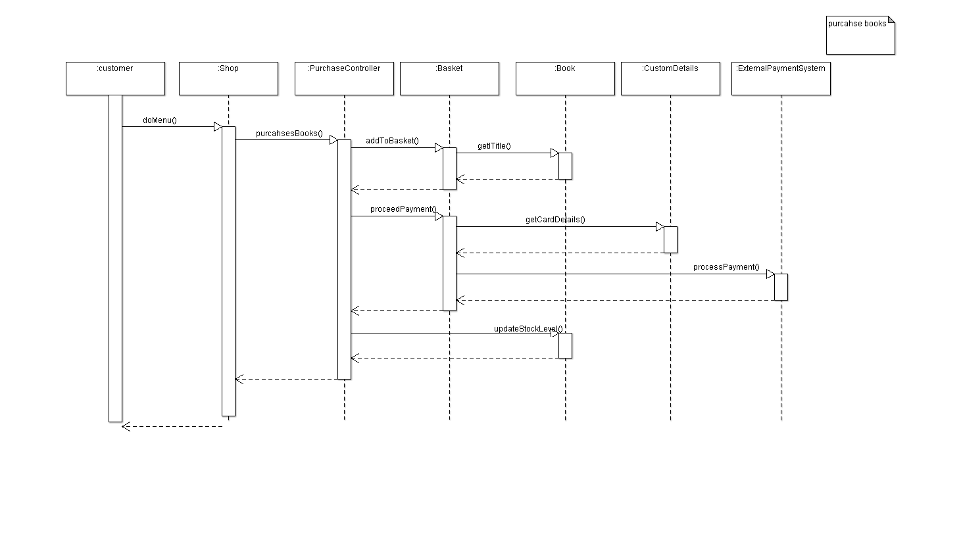
PurchaseBook

Slide 20
Test-driven development
Test-driven development (TDD) is an approach to program development in which you inter-leave testing and code development.
Tests are written before code and ‘passing’ the tests is the critical driver of development.
You develop code incrementally, along with a test for that increment. You don’t move on to the next increment until the code that you have developed passes its test.
TDD was introduced as part of agile methods such as Extreme Programming. However, it can also be used in plan-driven development processes.

Slide 21
Test-driven development
Notes:
Start by identifying the increment of functionality that is required. This should normally be small and implementable in a few lines of code.
Write a test for this functionality and implement this as an automated test.
Run the test, along with all other tests that have been implemented. Initially, you have not implemented the functionality so the new test will fail.
Implement the functionality and re-run the test.
Once all tests run successfully, you move on to implementing the next chunk of functionality.
Code refactoring is a "disciplined technique for restructuring an existing body of code, altering its internal structure without changing its external behavior",^{[1]}
Refactoring is "the process of changing a software system in such a way that it does not alter the external behavior of the code yet improves its internal structure," according to Martin Fowler

Slide 22
Benefits of test-driven development
Code coverage
Every code segment that you write has at least one associated test so all code written has at least one test.
Regression testing
A regression test suite is developed incrementally as a program is developed.
Simplified debugging
When a test fails, it should be obvious where the problem lies. The newly written code needs to be checked and modified.
System documentation
The tests themselves are a form of documentation that describe what the code should be doing.
Notes:
Regression testing is any type of software testing that seeks to uncover new software bugs, or regressions, in existing functional and non-functional areas of a system after changes such as enhancements, patches or configuration changes, have been made to them.
i.e. after each new feature, bugs may be found with the current system.

Slide 23
Key points
Testing can only show the presence of errors in a program. It cannot demonstrate that there are no remaining faults.
Development testing is the responsibility of the software development team. A separate team should be responsible for testing a system before it is released to customers.

Slide 24
Key points for the unit
Development testing includes unit testing, in which you test individual objects and methods.
Component testing in which you test related groups of objects and system testing, in which you test partial or complete systems.
When testing software, you should try to ‘break’ the software by using experience and guidelines to choose types of test case that have been effective in discovering defects in other systems.
Test-first development is an approach to development where tests are written before the code to be tested.

Slide 25
Reference
Most of the slides in this unit are based on the lecture slides from chapter 8 Software Testing in Software Engineering 9/E by Ian Sommerville
http://ifs.host.cs.st-andrews.ac.uk/Books/SE9/Presentations/index.html

